Slide 1
Kirsten Guenzel
Room B203
Email: Kirsteng@spokaneschools.org
1st Period World History
2nd, 3rd, and 5th period Advanced Placement World History
6th Period Advanced Placement Psychology
Advisory for National Honor Society

Slide 2
General Classroom Policies and Procedures:
Behavior Expectations and Policy
Show courtesy, respect, and patience for others.
Give every task your best effort.
Become an involved participant.
Be prepared to learn. Be in class daily, on time, and with the required materials and attitude that will help you succeed.
Be a self-directed learner. If you need help, clarification, or want to have more info, take action. You can come to me any time and I will do my best to help you.
Dear parents and guardians,
Welcome to the new school year. I am very excited to be part of your child’s learning experience this year. Please know that my door is always open to hear your concerns about your child’s progress or celebrate their successes. We’ve all learned a lot in the last 18 months so we are all invested in getting your kiddo back on track to graduation and beyond.
All the best, Kirsten Guenzel

Slide 3
1st Period World History
Class Content
Based on the district’s World History curriculum guidelines, students in my World History class will be working towards two assessments during first semester.
The first assessments will be geared towards the “Age of Exploration” between 1492-1700
This will be a research essay in which students will bring their strongest writing abilities to the success of this project.
curriculum leading up to the assessment will be for building background knowledge
1st Semester Content
Term | Knowledge building units *knowledge building units support the end of quarter assessment success | Assessment
Quarter 1 | Rise of Civilizations Global Religions Rise of Islamic Empires Rise of European Empires Achievements in the Americas | District QT 1 Assessment Age of Encounter Research Essay *See Scope and Sequence
Quarter 2 | Transformations in Europe Global Revolutions *America *France *Haitian *Latin America | District QT 1 Assessment or Alternative [Industrial Revolution DBQ] *See Scope and Sequence

Slide 4
2nd, 3rd and 5th period Advanced Placement World History
AP WH Curriculum:
AP WH Units at a glance:
In AP World History: “Modern, students investigate significant events, individuals, developments, and processes from 1200 to the present. Students develop and use the same skills, practices, and methods employed by historians: analyzing primary and secondary sources; developing historical arguments; making historical connections; and utilizing reasoning about comparison, causation, and continuity and change over time. The course provides six themes that students explore throughout the course in order to make connections among historical developments in different times and places: humans and the environment, cultural developments and interactions, governance, economic systems, social interactions and organization, and technology and innovation”

Slide 5
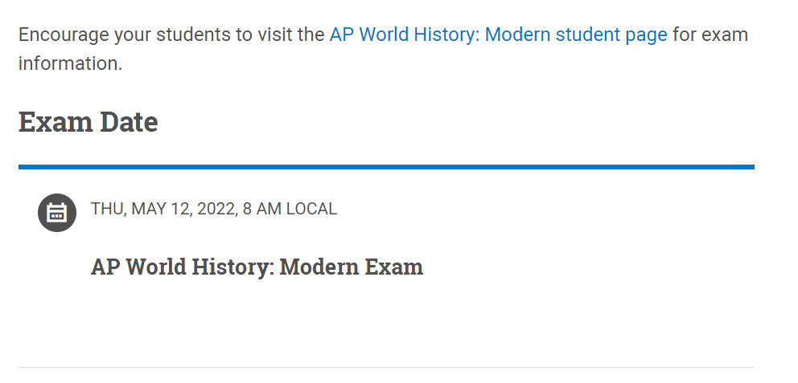
2nd, 3rd and 5th period Advanced Placement World History
Advanced Placement :
AP WH EXAM / FINAL Date
For more information about the Advanced Placement World History curriculum, please visit the Collegeboard website at:
https://apcentral.collegeboard.org/courses/ap-world-history
Students will begin the registration process next month
Registration is OPTIONAL
In the past, there has been exam funding for students who would like to sit for the exam but are in financial hardships. More information to follow next month
This year the Advanced Placement Collegeboard World History Exam is scheduled for:

Slide 6
6th period Advanced Placement Psychology
AP WH Curriculum:
AP Psychology Units
The AP Psychology course is designed to introduce students to the systematic and scientific study of the behavior and mental processes of human beings and other animals. Students are exposed to the psychological facts, principles, and phenomena associated with each of the major subfields within psychology. They also learn about the ethics and methods psychologists use in their science and practice.

Slide 7
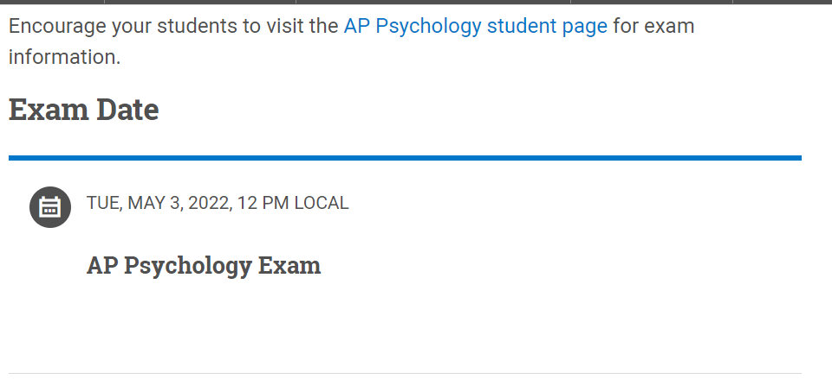
6th period Advanced Placement Psychology
Advanced Placement :
AP WH EXAM / FINAL Date
For more information about the Advanced Placement World History curriculum, please visit the Collegeboard website at:
https://apcentral.collegeboard.org/courses/ap-psychology?course=ap-psychology
Students will begin the registration process next month
Registration is OPTIONAL
In the past, there has been exam funding for students who would like to sit for the exam but are in financial hardships. More information to follow next month
This year the Advanced Placement Collegeboard World History Exam is scheduled for:

Slide 8
SPHS National Honor Society Advisory club
Recognizing honors level academics at SPHS
Our SPHS – NHS is currently 88 members strong and growing every year. This week we delivered over 100 invitations to new students in all grade levels that qualified for honor recognitions between 2019-2021.
We are very excited to see what these new members bring to a valued club
Leaders in: Scholarship, Leadership, Service and Character
Community service: toy drive, food drive, teen clothing drive, fundraising and community support

